Slide 1
Inference At Scale Week 1

Slide 2
Agenda
About the course
Talk about the use case and the solution
Review the Azure Architecture
Synapse walk through: pipelines, notebooks, linked services, git configuration, spark pools
Azure OpenAI walk through: Deploying and configuring models
Scaling Azure OpenAI Model Deployments

Slide 3
About the course
This course is about how to perform inference large amounts of data with a combination of Apache Spark (Azure Synapse) and Azure OpenAI
We are going to focus more on the prompting and accuracy assessments than on the use of Spark. Apache Spark is a huge topic on its own but using an Azure Service Like Synapse helps you to get going quickly.

Slide 4
Use Cases At The VA
Going through 1.5M doctor’s notes a day and identifying social determinants of mental health - Classification
Extracting nodule information out of radiology notes to see if diagnostic codes were missed – Extraction
Summarizing radiology notes to see if diagnostic codes were missed – Summarization

Slide 5
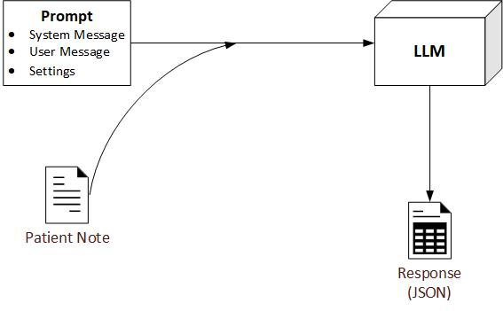
Grounding Your Data for Accurate Prompting
Three NLP relevant capabilities with prompting LLMs
Text Extraction
Summarization
Classification

Slide 6
Accuracy Assessments
There are three main actions that we are going to take on our data with a large language model
Classification
Extraction
Summary
We need to know how accurate our actions will be. Inaccuracies can really add up over a large dataset.
For classification we’ll use confusion matrices
For extraction we’ll use accuracy counts
For summary we’ll use LLM as a Judge

Slide 7
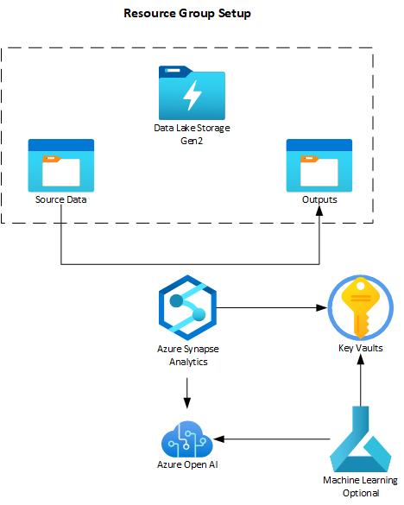
Base Architecture
The Synapse instance is reading data from the source, sending the data with a prompt to a model in the Azure OpenAI service and writing the result to the target.
In the MAG environment, authentication to the Azure OpenAI service is by key only. Hopefully, that will change soon.
The Azure Machine Learning instance is there for prompt engineering efforts.

Slide 8
Azure OpenAI Models By Region
AzGov
gpt-35-turbo 300K TPM
gpt-4 80K TPM
gpt-4o 80K TPM
gpt-4o-mini 2M TPM
text-embedding-3-large 350K TPM
text-embedding-ada-002 350K TPM
VaGov
gpt-35-turbo 300K TPM
gpt-4 80K TPM
gpt-4o – 80K TPM
text-embedding-ada-002 350K TPM
You should be using either gpt-4o-mini or gpt-4o. gpt-35-turbo gives much poorer results and gpt-4 is too slow and expensive.

Slide 9
Azure OpenAI Costs
Pay Go
Each model has a cost in tokens/cents
Every model has a different paygo cost
gpt-4o-mini is the cheapest and fastest
Pay go capacity is set by model and region
PTU (Provisioned Throughput Units)
Fixed price for a capacity set in TPM
Minimum PTU buy in Federal right now is 50 PTUs and costs about $27K per month.
You can’t split up the PTUs between different models
PTU buys are by model and region

Slide 10
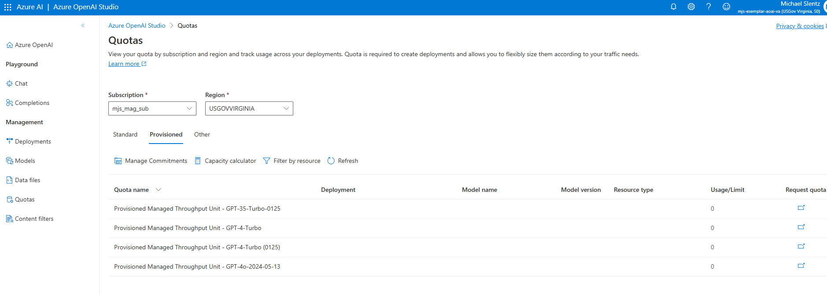
Azure OpenAI Cost Calculator
Figure out the average token per request and the number of requests per minute and it will calculate the PTUs
You can also request more pay-go capacity from here

Slide 11
Estimating Tokens In Your Dataset
Pay-go model costs are given by (some dollar amount/ some # of Tokens) for input tokens and (some dollar amount/ some # of Tokens) for output tokens.
Current costs for pay go gpt-4o in AzGov are input: $.0063/1000 Tokens and output: $.0188/1000 tokens.
A token is a part of a word. A good rule of thumb for estimating tokens is multiply the number of words in your dataset by 1.3. You can calculate costs by taking that result and applying the cost formulas above. Don’t forget to include the number of tokens in your prompt.

Slide 12
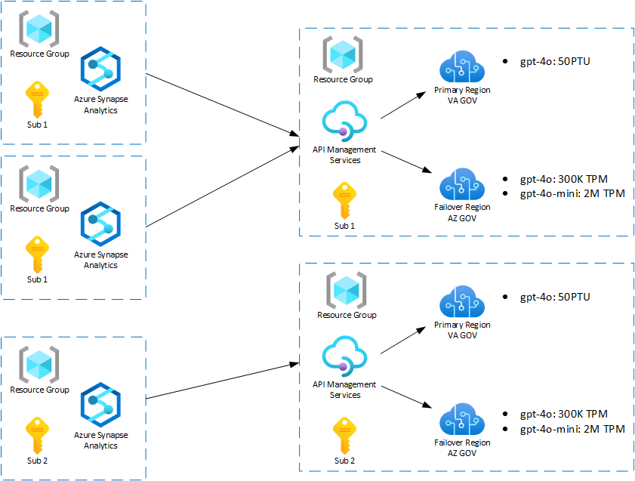
Azure OpenAI Capacity Planning
Setting up high availability / high capacity for Azure OpenAI
AOAI model capacity set by subscription and region
Some regions are missing options for model deployments
Model capacity can be increased by submitting tickets
microsoft/AzureOpenAI-with-APIM: Deploy APIM. Auto-configure it to work with your Azure Open AI.
Authenticate to Azure OpenAI API - Azure API Management | Microsoft Learn

Slide 13

Notebook Setup For This Course
Install the AZ Cli
1
Follow the Python Start up Guide
2
Pip install the requirements.txt
3
Create your .env file
4

Slide 14
Homework
Look at the week-1 notebook in the homework folder.
Set up your Azure OpenAI instance.
Install the az-cli and python.
Ensure that you can connect to your Azure OpenAI service.
Calculate the estimated cost for running the text in the Symptom2Disease dataset.

